Slide 1
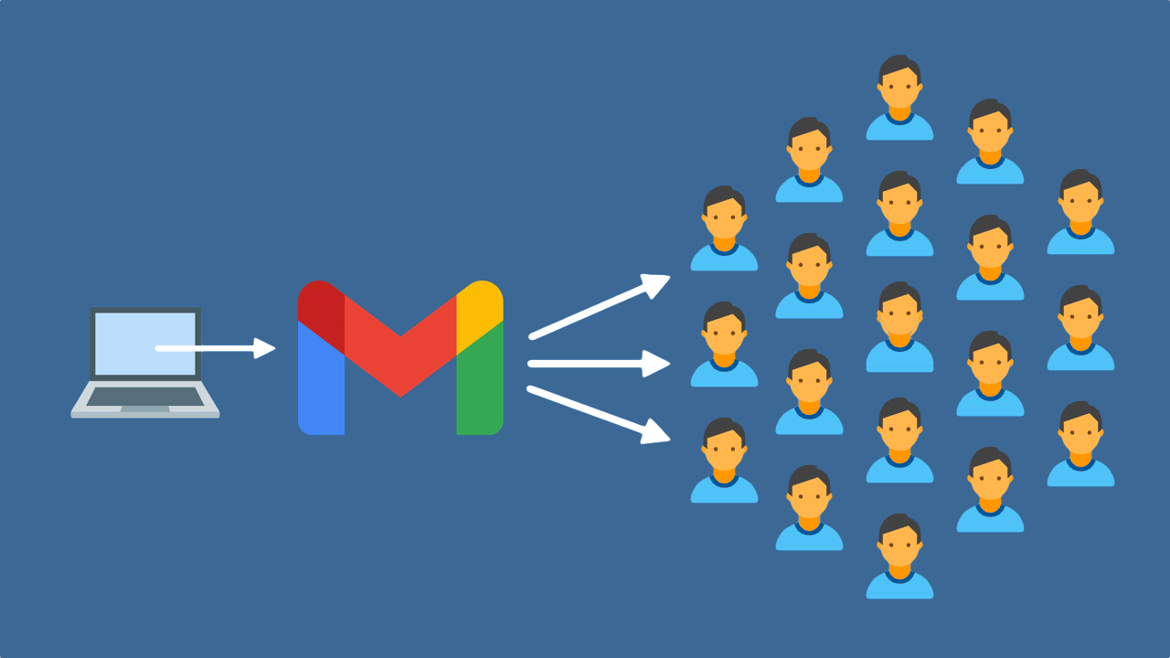

Slide 2
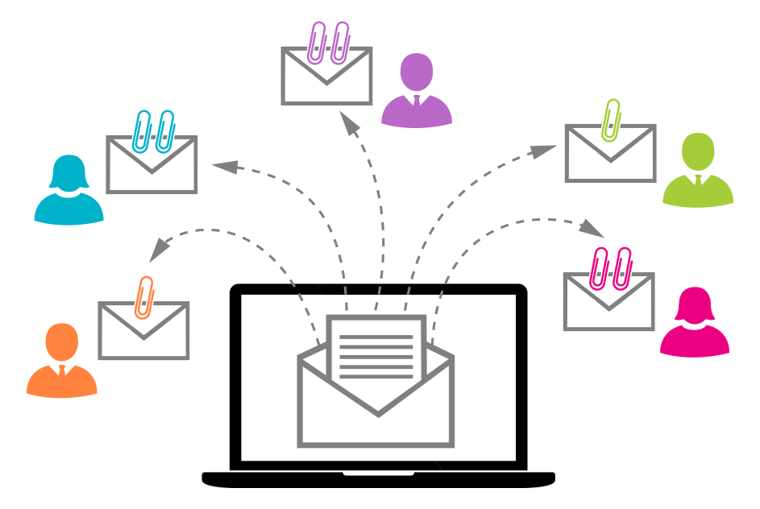
ABOUT MASS – MAIL
Mass Mail means a large number of email messages with similar content sent or received in a single operation of a series of related operations.
A mass mail is a marketing message sent by a brand to multiple recipients at once. It aims to promote a business, sell goods, and develop relationships

Slide 3
Mass- Mail Classification
Mass mail can be classified as one of two things
The first is as a physical mailing service that allows you to mail out multiple items at once. This makes the mailing process cheaper and easier to facilitate. Typically, physical bulk mail takes the form of pamphlets, letters, and brochures, or similar collaterals. This would depend entirely on the sender.
The second classification of bulk mail refers to mass email marketing and it happens when marketers send emails to large groups of people. Typically, marketers create one message for a business’s emailing list and send it out to them all at once as part of an email campaign.
Both methods are effective ways to reach a brand’s audience and gain potential customers.

Slide 4
What is Mass Mail used for?
Aside from being a fairly easy way to send out information, mass mail is usually used for advertising campaigns. A brand that’s looking to promote a new product or service can send out a mass email, as it’s one of the quickest ways to reach potentially interested customers.
Businesses and organizations often use mass mail to send out promotions, discounts, and coupons to loyal customers. However, mass mail is not solely meant for commercial purposes. It is also used by various educational, religious, and social organizations as a means of staying connected with their respective communities.

Slide 5
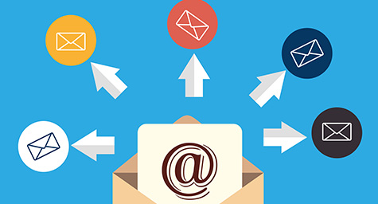
Benefits of Mass Mailing
Targets Suitable Audience
Personalize Message
Frequent Communications

Slide 6

Benefits of Mass Mailing
Cheaper Costs
Reach a larger number of customers
Reduced Time and Efforts

Slide 7


